Slide 1
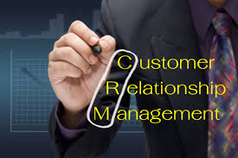
CUSTOMER RELATIONSHIP MANAGENET
SUBMITTED BY:- INDRA KUMAR B.
SUBMITTED TO :-
COURSE:- HTCS
BRANCH:- AMEERPET

Slide 2
WHAT IS CRM?
Successful CRM is about competing in the relationship dimension not as in alternative to have competitive product or responsible price, but as differentiator. If your competitions are doing same things as you are product and price wont give you as long-term, sustainable competitive advantage.
But if u can get an edge based on how customers feel about your company, it’s a much sticker, sustainable relationship over long haul.

